Slide 1
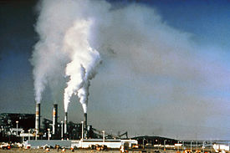
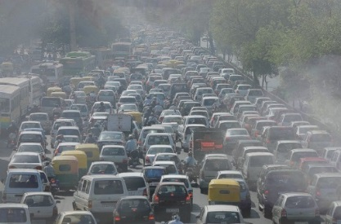

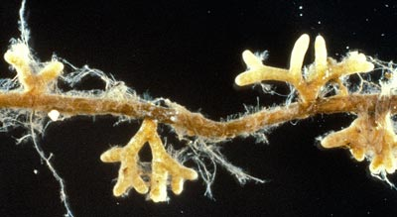

Critical Load
A tool to evaluate the sensitivity of terrestrial and aquatic ecosystems to air pollution
Version 1.0 – 11/06/18

Slide 2
Source and Reference for Presentation
This presentation was produced by the National Atmospheric Deposition (NADP)–Critical Loads of Atmospheric Deposition (CLAD) Science Committee Executive Team as a source of information and slides for presentations that include critical loads.
It is a product of NADP–CLAD. Any opinions, findings, conclusions, or recommendations as part of the slides and information herein do not necessarily reflect the views of CLAD, NADP, and/or respective members’ affiliations.
Please use the following as a reference for this presentation and/or individual slides from this presentation:
Phelan, J.N., Cummings, T.G., Bell, M.D., and Lynch, J.A. 2018. Critical Load – a tool to evaluate the sensitivity of terrestrial and aquatic ecosystems to air pollution (version 1.0). National Atmospheric Deposition Program, Wisconsin State Lab of Hygiene, University of Wisconsin – Madison, Madison, WI.
Notes:
This slide provides information on who produced the presentation and how to cite it or its contents

Slide 3
Critical Load Presentation Information and Guidance
This set of slides is meant to be a living document that serves as a resource for individuals making presentations related to critical loads of atmospheric deposition. The slides provide a broad overview of critical load science varying from simple definitions to complex biogeochemical relationships. The intent of including all of the information in the same format, is that when users pull from the presentation based on their needs (i.e., the user can use all or only some of the slides, based on their needs), the messaging will remain consistent across audiences. As the use of critical loads in a policy context has not been codified among agencies, this topic was intentionally left vague, with the expectation that a user will develop their own management or policy slides, based on their agency or organization priorities.
If you add content/information (and would like to contribute to this presentation), please use the following points as guidance:
  If you add information, specific examples, etc., please add your name and date beside each note in the notes field of the slide.
  If you add a new slide, please add your name and date in the notes field of the new slide.
  If you make additions to a slide, please describe the additions in the notes field (along with your name and date).
Please send inquiries, comments, and changes to the presentation to NADP–CLAD Program Manager – Jennifer Phelan (Jennifer.Phelan@slh.wisc.edu)
Notes:
This slide provides information about the presentation and how it is a living document that can be added to by users. We encourage users to add content and information, and provide guidance on how to document the additions.

Slide 4
Abbreviations in Presentation
Al – aluminum | NH₃ – ammonia
ARP – Acid Rain Program (U.S. EPA) | NH₄⁺ – ammonium
BLM – U.S. Bureau of Land Management | NO₃⁻ – nitrate
C – carbon | NPS – U.S. National Park Service
CL – critical load | NO_{x} – oxides of nitrogen
CLAD – Critical Loads of Atmospheric Deposition Science Committee of NADP | NYSERDA – New York Energy Research and Development Authority
CSPAR – Cross-State Air Pollution Rule | PM – particulate matter
EPA – U.S. Environmental Protection Agency | S – sulfur
FWS – U.S. Fish and Wildlife Service | SO₂ – sulfur dioxide
H₂SO₃ – sulfurous acid | SO₄²⁻ – sulfate
H₂SO₄ – sulfuric acid | SO_{x} – oxides of sulfur
HNO₃ – nitric acid | TDEP – Total Deposition (deposition dataset)
N – nitrogen | TNC – The Nature Conservancy
NADP – National Atmospheric Deposition Program | USFS – U.S. Forest Service
NCLD – National Critical Load Dataset | WSU – Washington State University
Notes:
This slide provides abbreviations and full text/names of terms that appear in the presentation.

Slide 5
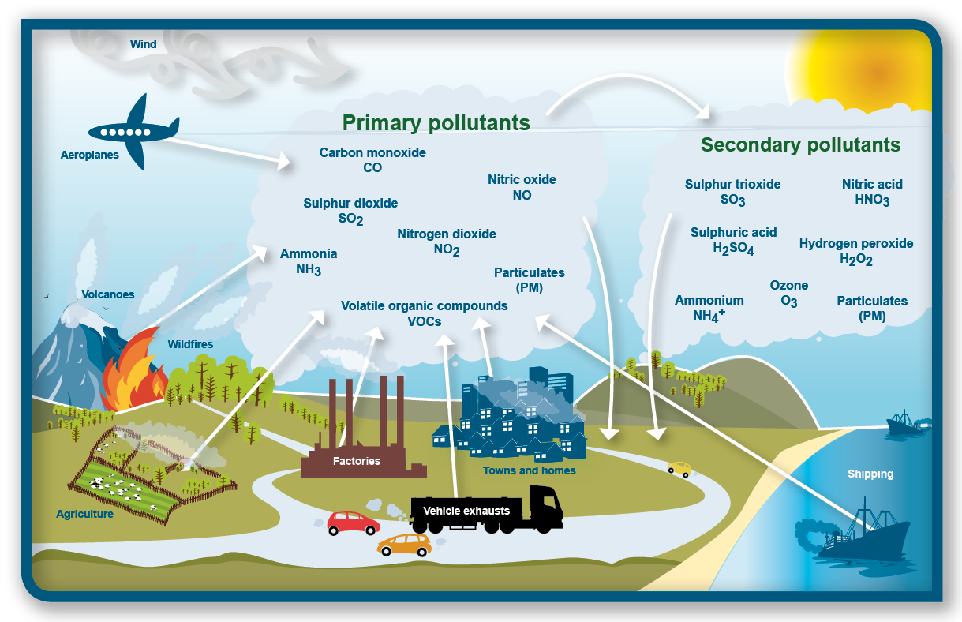
Nitrogen (N) and Sulfur (S) Air Pollution
http://www.mrgscience.com/ess-topic-63-photochemical-smog.html
Notes:
Summary slide that shows the main sources of N and S air pollution

Slide 6
Nitrogen (N) Species
Inorganic N:
  Oxides of N (NO_{x})
    Industrial and vehicle sources (combustion of fossil fuels)
    Lightning
    Precursor to ozone and particulate matter (PM)
    Forms nitric acid (HNO₃) in atmosphere; component of acid rain
  Ammonia (NH₃)
    Predominantly agricultural sources (application of fertilizers)
    Also from mobile sources with catalytic reduction
    Precursor to PM
    Becomes ammonium (NH₄⁺) in atmosphere (in precipitation)
Organic N
  Can be a significant contribution, but is less understood
Notes:
This slide outlines the main sources of different forms of atmospheric N pollution.

Slide 7
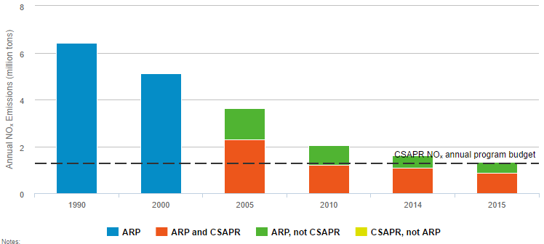
Annual Oxides of N (NO_{x}) Emissions from CSAPR and ARP Sources, 1990-2015
https://www3.epa.gov/airmarkets/progress/reports/emissions_reductions_nox.html
Notes:
Overall Results
Annual NOₓ emissions have declined dramatically under the ARP (Acid Rain Program), NOₓ Budget Trading Program (NBP), and CSAPR (Cross State Air Pollution Rule) programs, with the majority of reductions coming from coal-fired units.
These reductions have occurred while electricity demand (measured as heat input) remained relatively stable, indicating that the emission reductions were not driven by decreased electric generation.
These emission reductions are a result of an overall increase in the environmental efficiency at affected sources as power generators installed controls, ran their controls year-round, switched to lower emitting fuels, or otherwise reduced their NOₓ emissions while meeting relatively steady electricity demand.
Other programs—such as regional and state NOₓ emission control programs—also contributed significantly to the annual NOₓ emission reductions achieved by sources in 2015.
Dashed line in the figure is the CSAPR NOx annual program emission cap.
Annual NOₓ Emissions Trends
ARP: Units in the ARP NOₓ program emitted 1.3 million tons of NOₓ emissions in 2015, indicating that ARP sources reduced emissions by 6.8 million tons from the projected level in 2000.
CSAPR and ARP: In 2015, the first year of operation of the CSAPR NOₓ annual program, sources in both the CSAPR NOₓ annual program and the ARP together emitted 1.4 million tons, a reduction of 5.0 million tons (79 percent reduction) from 1990 levels, 3.8 million tons (73 percent reduction) from 2000, and 2.3 million tons (63 percent reduction) from 2005 levels.
CSAPR: Emissions from the CSAPR NOₓ annual program sources alone were about 905,000 tons in 2015. This is about 1.4 million tons (61 percent) lower than in 2005 and 360,000 tons (29 percent) below the CSAPR NOₓ annual program's 2015 regional budget of 1,269,837 tons.

Slide 8
Sulfur (S) Species
Oxides of S (SO_{x})
  Industrial sources; mainly combustion of coal and oil
  Forms sulfurous acid (H₂SO₃) and sulfuric acid (H₂SO₄) in the atmosphere; components of acid rain
  Precursor to PM
Notes:
This slide outlines the main sources of atmospheric S pollution.

Slide 9
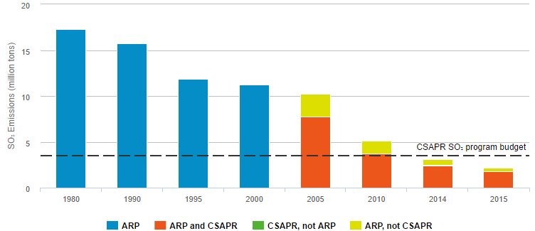
Oxides of S (SO₂) Emissions from CSAPR and ARP Sources, 1980-2015
https://www3.epa.gov/airmarkets/progress/reports/emissions_reductions_so2.html#figure1
Notes:
Overall Results
Under the ARP (Acid Rain Program) and now CSAPR (Cross-State Air Pollution Rule), power plants have significantly lowered SO₂ emissions while electricity demand (measured as heat input) remained relatively stable, indicating that the emission reductions were not driven by decreased total electric generation.
These emission reductions are a result of an overall increase in the environmental efficiency at affected sources as power generators installed controls, switched to lower emitting fuels, or otherwise reduced their SO₂ emissions while meeting relatively steady electricity demand.
Dashed line in the figure is the CSAPR SO₂ annual program emission cap.
SO₂ Emission Trends
ARP: Units in the ARP emitted 2.2 million tons of SO₂ in 2015. ARP sources reduced emissions by 13.5 million tons (86 percent) from 1990 levels and 15.1 million tons (87 percent) from 1980 levels.
CSAPR and ARP: All ARP and CSAPR sources together emitted a total of 2.2 million tons of SO₂ in 2015.
In 2015, sources covered by both the CSAPR SO₂ annual program and the ARP reduced SO₂ emissions by 13.5 million tons (86 percent) from 1990 levels (before implementation of the ARP), 9.0 million tons (80 percent) from 2000 levels (ARP Phase II), and 8.0 million tons (78 percent) from 2005 levels (before implementation of CAIR and CSAPR).
CSAPR: Annual SO₂ emissions from sources in the CSAPR SO₂ program alone fell from 7.7 million tons in 2005 to 1.8 million tons in 2015, a 77 percent reduction. In 2015, SO₂ emissions were about 1.7 million tons below the regional CSAPR emission budgets (1.3 million in Group 1 and 0.4 million in Group 2).

Slide 10
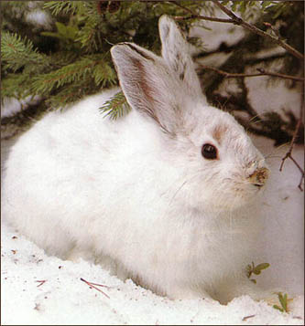


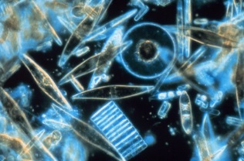
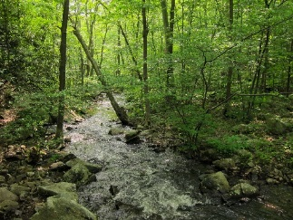
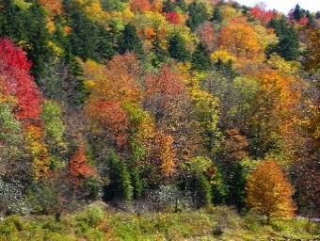

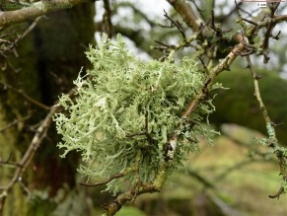
Why do we care?
Air pollution deposits to ecosystems in the form of wet and dry N and S deposition
Notes:
This slide begins to make the connection between air pollution, deposition, and impacts to terrestrial and aquatic ecosystems and the services provided by the ecosystems. As an example snow sho
Linda Geiser (01/03/18): Air pollution acidifies and eutrophies ecosystems from the deposition of wet and dry N and S.

Slide 11
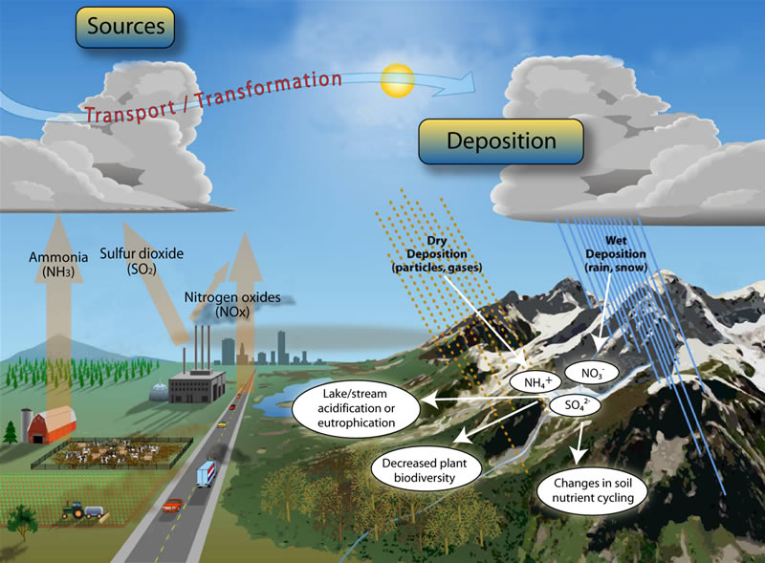
N and S Pollution Transport and Fate
https://nature.nps.gov/air/Studies/criticalLoads/DepExplain.cfm
Notes:
Summary slide that connects major sources, transport, and fate (deposition) of atmospheric N and S pollution. It should be noted that not all sources of emissions are shown. For example, both NOx and NH3 are on-road, mobile emissions.
Linda Geiser (01/03/18): add ‘fog’ under wet deposition
Linda Geiser (01/03/18): Soil acidification, nutrient N saturation, and chemical cycling affecting soil fertility
Linda Geiser (01/03/18): Shifts and ultimately decreases in plant and microbial biodiversity

Slide 12
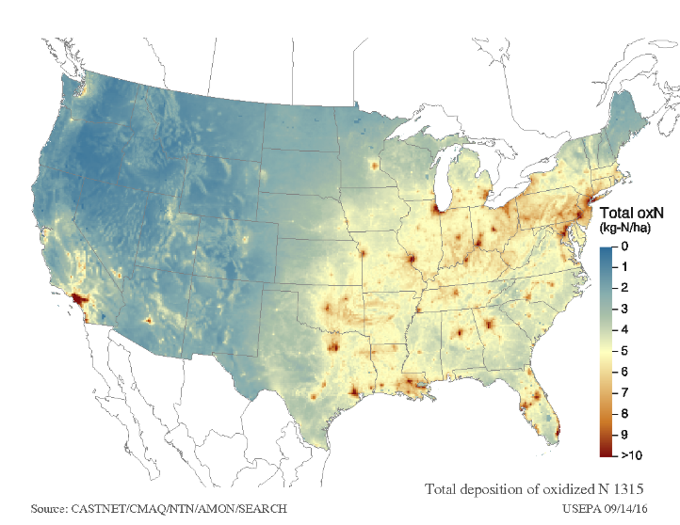
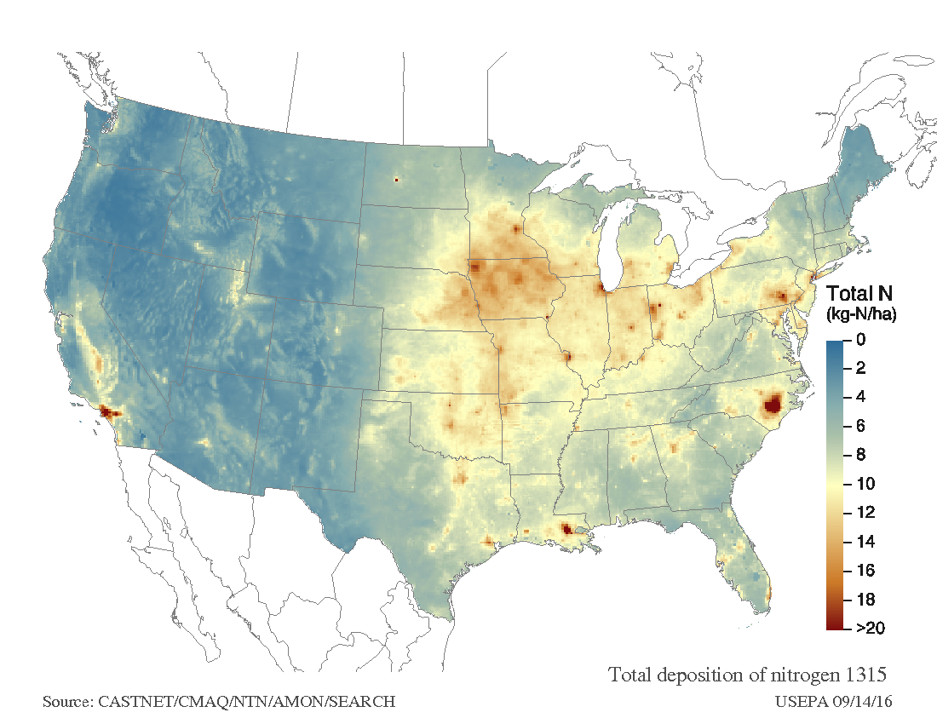
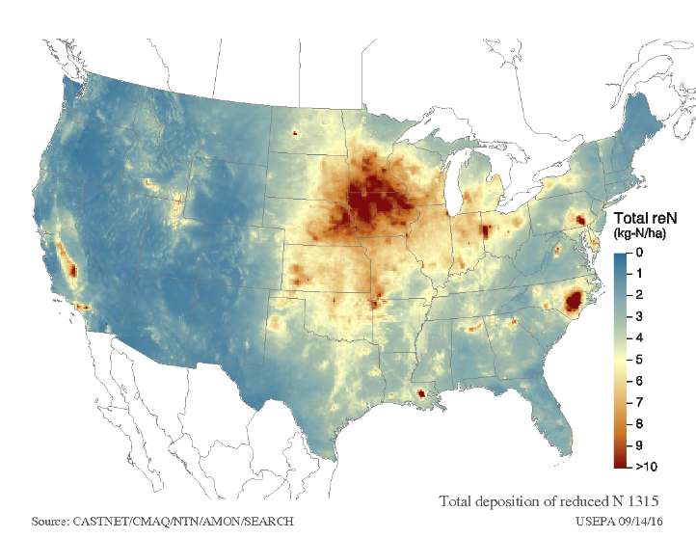
Nitrogen (N) Deposition – TDEP (2013-2015)
NO_{y}
NH_{x}
Total N
ftp://ftp.epa.gov/castnet/tdep/images/
Notes:
Estimates of N deposition (average of 2013-2015 annual deposition) for the conterminous U.S from TDEP (http://nadp.sws.uiuc.edu/committees/tdep/)

Slide 13
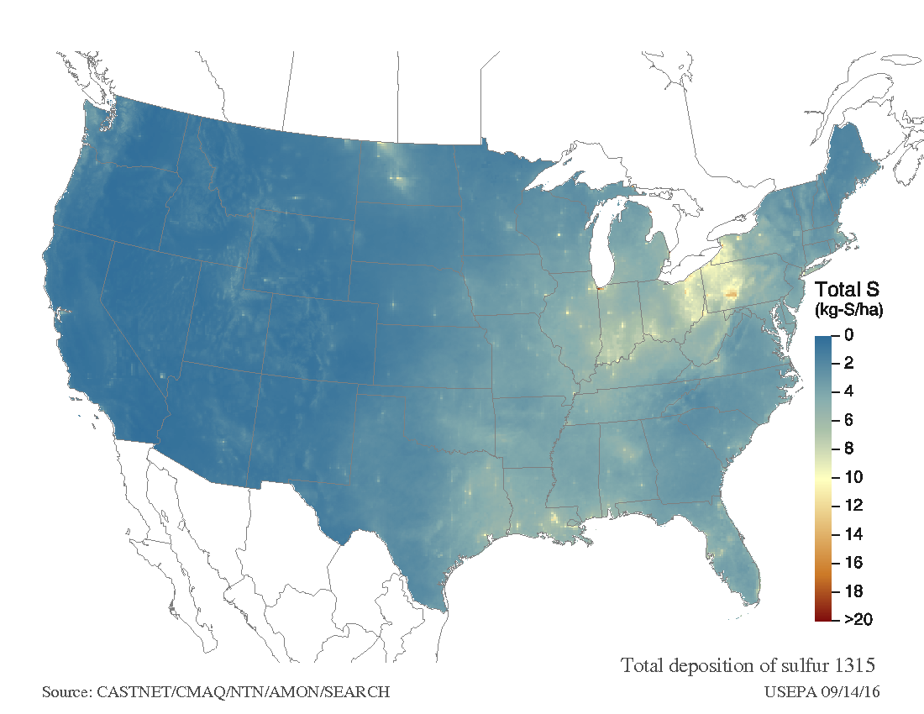
Sulfur (S) Deposition – TDEP (2013-2015)
ftp://ftp.epa.gov/castnet/tdep/images/
Notes:
Estimates of S deposition (average of 2013-2015 annual deposition) for the conterminous U.S from TDEP (http://nadp.sws.uiuc.edu/committees/tdep/)

Slide 14
Why do we care?
Air pollution deposits to ecosystems in the form of wet and dry N and S deposition
N and/or S deposition negatively impact the biota in terrestrial and aquatic ecosystems and the services they provide
Notes:
This slide continues to make the connection between air pollution, deposition, and impacts to terrestrial and aquatic ecosystems and the services provided by the ecosystems.

Slide 15
How do N and S deposition negatively impact ecosystems?
Eutrophication – excess N:
  Fertilizing effect in soils and drainage/surface waters (lakes, streams, and estuaries)
Acidification – excess S and/or N:
  Acidifies soils and drainage/surface waters
Notes:
This slide describes the mechanisms/how N and S impact and change the chemistry of soil and/or water in ecosystems.

Slide 16
Eutrophication – excess N
Fertilizing effect:
  Terrestrial and aquatic mechanisms:
    N is the limiting nutrient to growth in many terrestrial and aquatic ecosystems
    Excess N stimulates growth in many ecosystems
    Excess N changes competitive interactions and advantage, leading to changes in composition and diversity
    Increased nitrate (NO₃⁻) leaching to drainage/surface waters
Notes:
This slides provides more examples and information on the fertilizing/eutrophying effect of N deposition.

Slide 17
Acidification – excess N and/or S
Acidifies soils and drainage/surface waters:
  Terrestrial mechanisms:
    Increased aluminum (Al) in soil solution; Al is toxic to many plant species
    Leaching of base cations from rooting zone of soil; loss of nutrients and creation of nutrient imbalance
    Species of plants, trees, mycorrhizae, and lichens differ in their sensitivity to these conditions
  Aquatic mechanisms:
    Leaching of sulfate (SO₄²⁻) and NO₃⁻ leading to export of base cations and decreased pH and ANC in drainage/surface waters
    Increased Al in drainage/surface waters; Al is toxic to many aquatic species
    Species of aquatic macroinvertebrates, algae, and fish differ in their sensitivity to these conditions
Notes:
This slides provides more examples and information on the acidifying effects of N and S deposition.

Slide 18

How is N and/or S deposition negatively impacting your system?
Eutrophication OR Acidification?
*** mechanism is often not certain because N can act as a fertilizer and acidifying agent, and N and S deposition are often correlated; both mechanisms can be occurring in an ecosystem***
Notes:
This slide highlights that it is not always possible to determine which mechanism (fertilization or acidification) is impacting the biology of the system. Often, both are acting to varying degrees. It is also important to note that different species within an ecosystem (e.g., different plant species) may be impacted differently; some species may be more sensitive to acidity and others to eutrophication.

Slide 19
Ecosystem Effects of N Deposition
Annual Plants:
  Increased or decreased primary productivity
  Increased mortality
  Changes in community composition
  Loss of biodiversity
  Spread of invasive species
Invasive grass (Schismus spp.)in Sonoran Desert (Photo: E. Allen)
Notes:
This is the first in a series of slides that describes the biological responses of biological indicators (in this case plants) to N deposition. As before, the mechanism could be due to eutrophication, acidification or both.

Slide 20

Ecosystem Effects of N Deposition
Lichens:
  Changes in community composition
  Increases in nitrophilic/eutrophic species
  Loss of biodiversity
  Extirpation
Wolf lichen
Notes:
It should be noted that most of the work to date has evaluated the responses of epiphytic (on trees) lichens to N and S deposition.

Slide 21


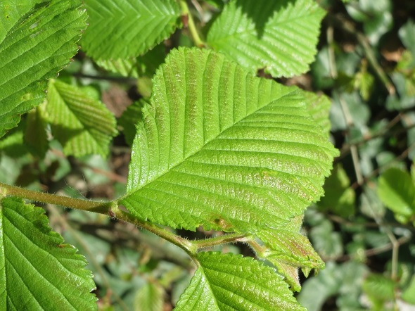
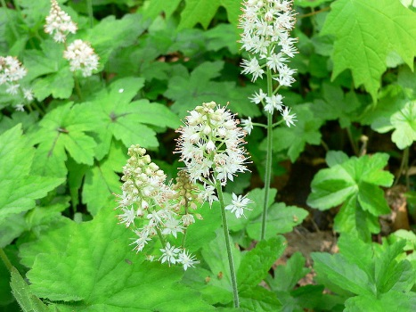
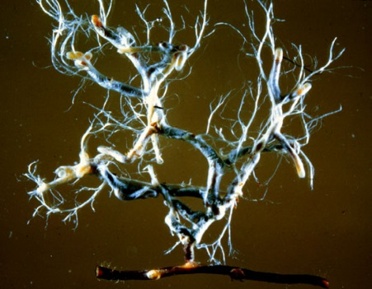
Ecosystem Effects of N Deposition
Forests:
  Loss of mycorrhizae
  Increased and decreased tree growth
  Increased mortality of trees
  Changes in forest composition
  Loss of biodiversity
Eastern hemlock
Ponderosa pine
Tiarella cordifolia
Ectomycorrhizae
Red elm
Notes:
Examples of tree species that have been found to respond negatively to N (from Horn et al., in review as of 03/05/18); exact mechanism not known:
- Red elm and slippery elm both have strong negative survival responses to N deposition, with and without S deposition.
- Eastern hemlock has consistent negative growth response to N deposition with and without S deposition.
- Strong decreases in ponderosa pine are associated with N deposition without S deposition in the model.
- Red spruce has strong growth decreases to N with and without S deposition.
Increased N can impact mycorrhizae by decreasing overall abundance and species diversity
Tiarella cordifolia and the other species listed here, show monotonic unconditional negative responders to N:
Carex brunnescens
Carex disperma
Cinna latifolia
Conyza canadensis
Goodyera pubescens
Gymnocarpium dryopteris
Hexastylis virginica
Hydrophyllum canadense
Juncus effusus
Lespedeza procumbens
Lespedeza repens
Lysimachia quadriflora
Muhlenbergia cuspidata
Prosartes lanuginosa
Pycnanthemum virginianum
Rudbeckia hirta
Tiarella cordifolia
Trillium erectum
Verbascum thapsus
Veronicastrum virginicum
Viola canadensis

Slide 22
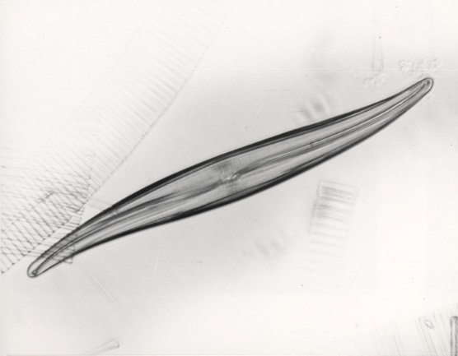
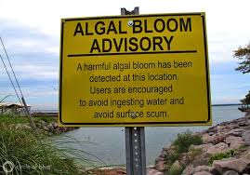
Ecosystem Effects of N Deposition
Drainage/Surface waters:
  Increased algal and/or cyanobacterial growth
  Decline in diatom diversity
  Changes in composition of aquatic biota
  Together with other sources of nitrogen
  can lead to algal bloom
Gyrosigma acuminatum (diatom)

Slide 23


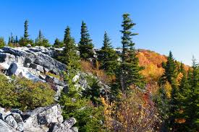
Ecosystem Effects of Acidifying N and S Deposition
Terrestrial Ecosystems:
  Decreased tree growth
  Increased mortality of trees
  Decreased survival of seedlings
  Changes in forest composition
  Loss of biodiversity
Yellow birch
Sugar maple
Red spruce
Notes:
This is the first in a series of slides that describes the biological responses of biological indicators (in this case plants) to N and S deposition. In this case, the mechanism is acidification and biological responses to the conditions caused by acidification (e.g., leaching of base cations and increased mobilization of phytotoxic aluminum, nutrient imbalance, reduced base saturation, reduced base cation/aluminum ratio in soil solution). However, as indicated in this list of responses, it should be noted that although the mechanism may differ the biological responses of the biological indicators can be the same.
Linda Geiser (01/03/18): Most of these impacts are reversed at low levels– i.e. promotion of growth, decreased mortality, increased survival, increased diversity—but all affects observed at high N deposition levels—what is ‘high’ is different for each species..

Slide 24


Ecosystem Effects of Acidifying N and S Deposition
Drainage/Surface waters:
  Loss of aquatic biodiversity
  Reduced population health, reproduction capacity, and fitness
  Loss of fish, macroinvertebrate, and amphibians from streams/lakes
Notes:
Linda Geiser (01/03/18): add to last bullet: related to declines in food or intolerance of life stages to lower pH

Slide 25
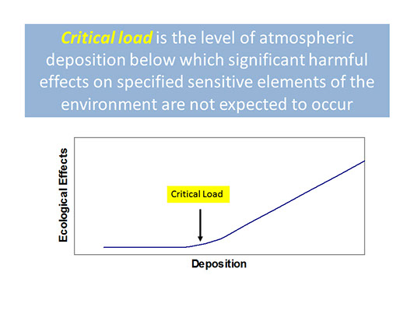
So, how much deposition is too much?
Critical Load
A quantitative estimate of exposure to one or more pollutants below which significant harmful effects on specified sensitive elements of the environment do not occur according to present knowledge (Nilsson and Grennfelt 1988; UBA, 2004).
https://www.srs.fs.usda.gov/airqualityportal/critical_loads/cls_background.php
Notes:
This slides provides the definition of critical load.
Nilsson and Grennfelt (1988) full reference – Nilsson J, Grennfelt P (eds.) (1988) Critical loads for sulphur and nitrogen. Report from a workshop held at Skokloster, Sweden 19-24 March 1988. Miljorapport 15, 1-418.
UBA full reference - UBA [UmweltBundesAmt]. 2004. Manual on methodologies and criteria for mapping critical levels/loads and geographical areas where they are exceeded. Federal Environmental
Agency (UmweltBundesAmt), Berlin, Germany. http://www.rivm.nl/en/themasites/icpmm/manual-and-downloads/manual-english/index.html

Slide 26
Components of a
Critical
Load
Deposition either:
directly impacts biota, or
changes soil or water chemistry that impacts biota
Changes to soil or water chemistry exceed a threshold amount beyond which biota (biological receptor) is negatively impacted
Change in biological receptor (biological response) exceeds a threshold amount
Notes:
This slide displays the components of a critical.
1. Deposition changes the chemistry of the soil or water. Chemical Criterion is the chemical measure affected by atmospheric deposition that is used to predict the increased probability of damage to the biological receptor of interest (Aherne et al. 2001). Chemical criterion is also referred to as chemical indicator. Some examples of chemical criteria are soil base saturation, soil solution base cation to aluminum ratio, surface water acid neutralizing capacity (ANC), and drainage/surface water NO3-. Chemical Threshold is the threshold or value of the chemical criterion beyond which the biological receptor of interest is negatively impacted. The critical load of a system is the point where deposition levels result in the value of the chemical criterion being equal to the chemical threshold. Chemical threshold is also referred to as critical limit. Some examples of chemical thresholds are 20% base saturation to protect
forest growth and health, and ANC of 50 μeq/L to protect the majority of acid-sensitive aquatic biota.
2. Altered soil or water chemistry negatively impacts a sensitive Biological Receptor. Biological Receptor: A biological element that is impacted by the conditions created by atmospheric deposition. Biological receptor is also referred to as biological indicator and biological end point. Biological Response: The biological measure affected by atmospheric deposition that represents the increased probability of damage to the biological receptor of interest. Some examples of biological responses are decreased growth rates, increased mortality, reductions in species richness, changes in species composition, and increases in invasive species. Biological Threshold: The threshold or value of the biological response beyond which the biological receptor of interest is considered to be negatively/adversely impacted. An example of a biological threshold is a change in species composition greater than 10% (McDonnell et al. 2014).
For some critical loads (e.g., modelled critical loads), there are known relationships between deposition – changes in soil/water chemistry – changes in biological receptor. For other critical loads (e.g., empirical critical loads), only the relationship between deposition and response of biological receptor(s) is known (i.e., the mechanism or changes in soil/water chemistry is not well known or quantified).

Slide 27
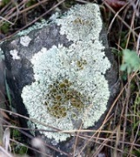

Critical Load
Critical loads are defined for specific biological indicators, receptors, or endpoints
Critical load values differ and reflect different sensitivities of different biological indicators to deposition
Biological receptors can have a range of critical load values; sensitivities can vary by location
Change in lichen species composition
Forest ecosystem critical loads
Sensitivity
CL = 1.5-12.7 kg N/ha/yr
Change in herb diversity
CL = 3-39 kg N/ha/yr
CL = 7.9-19.6 kg N/ha/yr
N deposition (kg/ha/yr)
Notes:
This slide further describes critical loads (using terrestrial CL of N as an example), and how critical loads are specific to sensitive biological receptor in an ecosystem and can differ by species (and location) based on different sensitivities to conditions created by deposition (and other factors).
Source of Lichen CL = NCLD v3.0
Source of Herb diversity CL = Simkin et al. (2016) - Simkin, S., C. Clark , W. Bowman, E. Allen, J. Belnap, and L. Pardo. Conditional vulnerability of plant diversity to atmospheric nitrogen deposition across the United States. PNAS (PROCEEDINGS OF THE NATIONAL ACADEMY OF SCIENCES). National Academy of Sciences, WASHINGTON, DC, USA, 113(15): 4086-4091, (2016).
Source of Forest Ecosystem CLs = Pardo, et al. 2011. Effects of nitrogen deposition and empirical critical loads for nitrogen for ecological regions of the United States. Ecological Applications 21(8): 3049-3082. Tree species survival and growth CLs may be added at a future date after the publication of Horn et al. (in review).
Linda Geiser (01/03/18): Also note that effects on more sensitive species can have ramifications for less sensitive, commercially or recreationally desirable species if they depend on more sensitive species for food or habitat. For example overgrowth of algae can remove oxygen from surface waters and reduce fish survival. Or impacts on mycorrhizal fungi can reduce tree growth. Or loss of lichens can reduce food for birds that prey on insects which are more abundant in lichen covered than bare branches.

Slide 28





Critical Load
Critical loads are defined for specific biological indicators, receptors, or endpoints
Critical load values differ and reflect different sensitivities of different biological indicators to deposition
Biological receptors can have a range of critical load values; sensitivities can vary by location
Change in diatom
species composition
Change in algal
species composition
Change in macroinvertebrate community
Reduction in sensitive fish species
Sensitivity
Reduction in non-sensitive fish species
e.g., Blacknose dace
e.g., brook trout
Change in Water Quality with increasing
N and S deposition (kg/ha/yr)
Notes:
This slide further describes critical loads (using aquatic CL of acidity (N+S deposition) as an example), and how critical loads are specific to sensitive biological receptor in an ecosystem and can differ by species (and location) based on different sensitivities to conditions created by deposition (and other factors).

Slide 29
How are critical loads determined?
Empirical critical load:
  involves observed spatial or temporal gradient studies or experimental manipulations of pollutants
  applied to sites or landscapes that are ecologically comparable to location(s) from which critical loads were determined
Steady-state mass balance critical load:
  derived from mathematical mass-balance models under assumed or modeled equilibrium conditions
  models vary in complexity with regard to process representation
Notes:
This slide provides a brief description of the different ways/models/methods used to estimate critical loads.

Slide 30
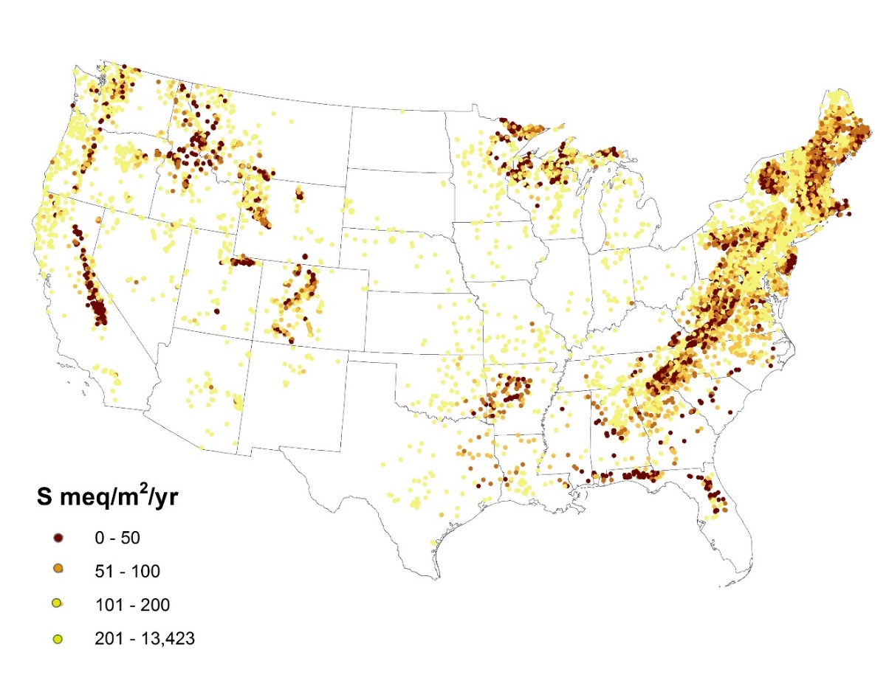
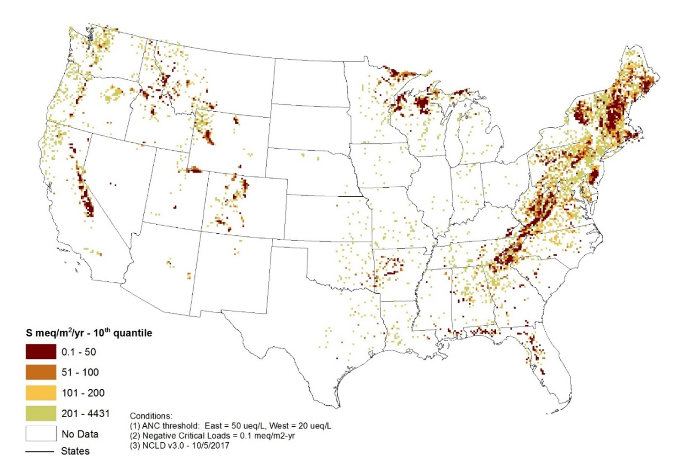
Examples of Critical Load maps
Aquatic Acidification (by location)
Aquatic Acidification – 10th quartile (aggregated by 12-km grid cells)
http://nadp.sws.uiuc.edu/committees/clad/db/NCLDMapSummary_2016.pdf
Notes:
These CL maps are produced by NADP-CLAD and are included in the 2016 NADP-CLAD Critical Load Map Summary. The data for these maps are in the NADP-CLAD National Critical Load Database (NCLD) v3.0. Aquatic Acidification CLs are from a variety of sources/publications/studies/types of models.
10th quartile map represents the 10th quartile of all aquatic acidification CL values within 12-km grid cells; 12-km grid cells were selected for consistency of the resolution of CMAQ deposition
These maps are for Aquatic Acidification CLs of S deposition (i.e., CLmaxS).

Slide 31
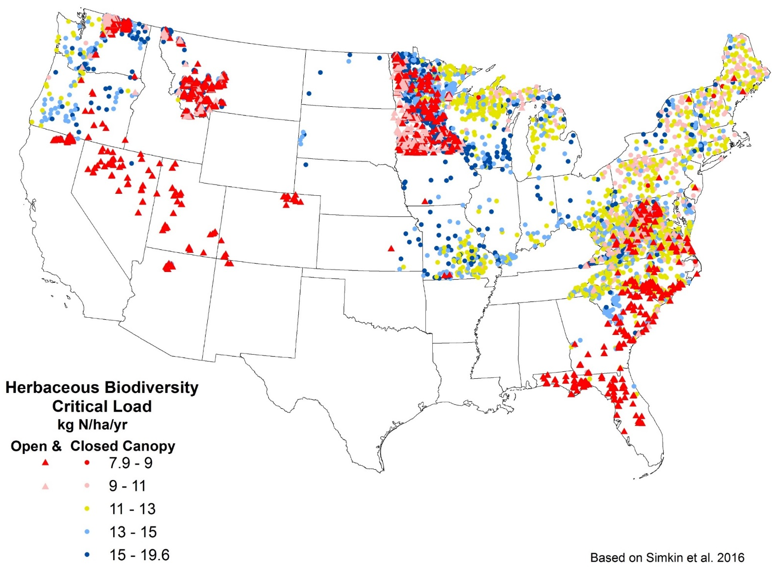
Examples of Critical Load maps
http://nadp.sws.uiuc.edu/committees/clad/db/NCLDMapSummary_2016.pdf
Notes:
These CL maps are produced by NADP-CLAD and are included in the 2016 NADP-CLAD Critical Load Map Summary. The data for these maps are in the NADP-CLAD National Critical Load Database (NCLD) v3.
This map is for Empirical CLs of N for Herbaceous Species Biodiversity or Species Richness at the plot level (in open (grasslands and shrublands) and closed (forest) systems).
Data is from Simkin et al. (2016) - Simkin, S., C. Clark , W. Bowman, E. Allen, J. Belnap, and L. Pardo. Conditional vulnerability of plant diversity to atmospheric nitrogen deposition across the United States. PNAS (PROCEEDINGS OF THE NATIONAL ACADEMY OF SCIENCES). National Academy of Sciences, WASHINGTON, DC, USA, 113(15): 4086-4091, (2016).

Slide 32
What happens if deposition is greater than a critical load?
Critical Load Exceedance
The critical load is exceeded if the deposition load of a pollutant is greater than or equal to the critical load of the pollutant for the same location.
The source of the deposition load estimate is defined by the user.
In mathematical terms, the exceedance (Ex) of the critical load CL(X) is given as:
Ex(Xdep) = Xdep – CL(X)
Notes:
This slide provides a definition of critical load exceedance.

Slide 33
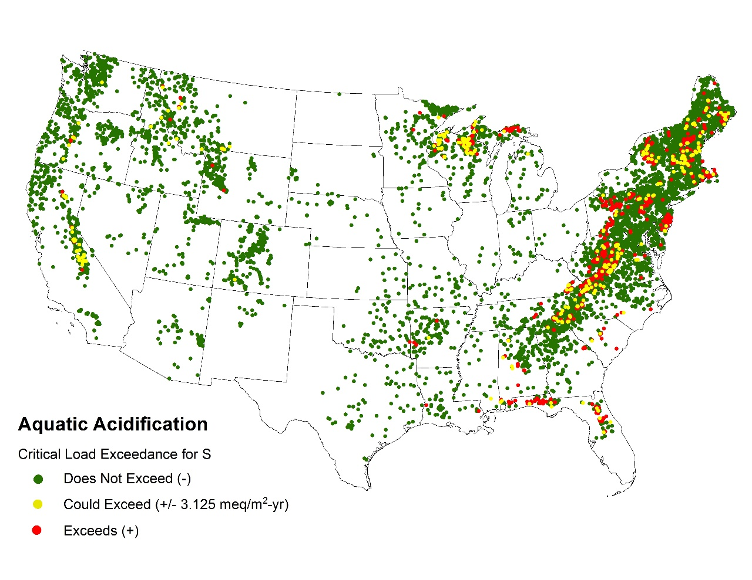
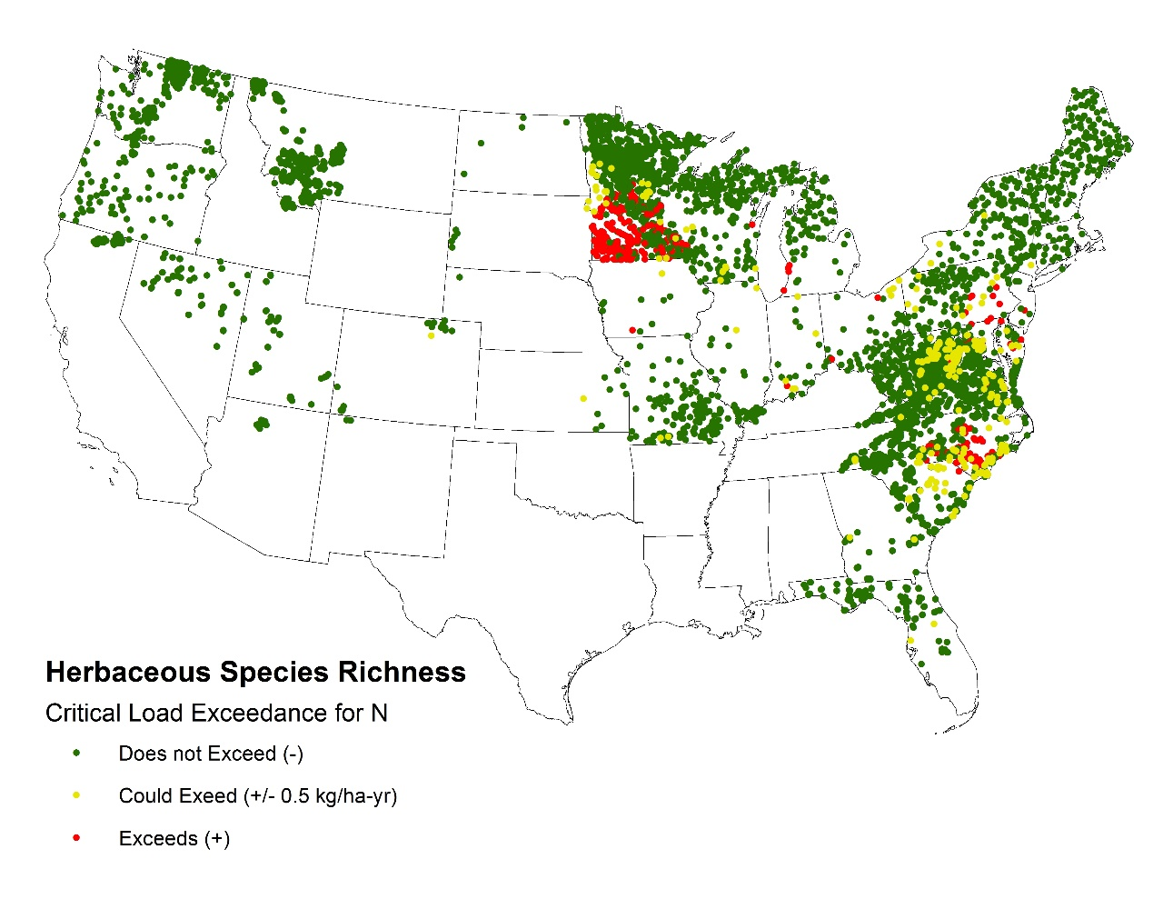
Examples of Critical Load Exceedance maps
Notes:
These CL exceedance maps are based on comparisons of Aquatic Acidification and Herbaceous Biodiversity with 3-year (2013-2015) average TDEP deposition estimates.

Slide 34
Critical Loads for A and B are exceeded
Critical Load Exceedance
Change in Biological Receptor A
Change in Biological Receptor B
A
Change in Biological Receptor C
CL = 0.3 kg N/ha/yr
B
Change in Biological Receptor D
Sensitivity
C
CL = 0.5-1.0 kg N/ha/yr
D
CL = 2-3kg N/ha/yr
CL = 5-10 kg N/ha/yr
N deposition (kg/ha/yr)
Notes:
This slide shows 4 different biological indicators with different sensitivities (and therefore different critical loads) to N deposition. At a certain deposition level, some critical loads may be exceeded, while others are not (emphasizing the varying sensitivity of different biological receptors to the conditions created by N and/or S deposition).

Slide 35
What happens when a critical load is exceeded?
Biological indicator is negatively impacted
Biological responses:
  Increased or decreased growth
  Decreased survival
  Loss of species
  Reduced biodiversity
  Change in species composition
  Disruptions in food web dynamics
Response may not occur immediately
Notes:
Re-iterates the biological responses of the biological receptors when a critical load is exceeded. Very often a certain amount or magnitude of negative biological response is used to determine the critical load (i.e., how much negative response is too much and clearly beyond (e.g., statistically significant difference) that attributable to natural variation).
It should also be noted that the biological indicator may not respond immediately. It may take a while (i.e., several years or decades) to show a negative response (due to episodic events (e.g., critical load exceeded in single year due to deposition spike) and/or the response times in water and/or soil conditions and/or response times of biological indicators – e.g., trees may take longer to respond than annual herbs).

Slide 36
How are critical loads used?
State agencies –
  risk assessment and policy development (e.g., NYSERDA)
Federal agencies –
  in support of natural resource/land management (e.g., NPS, USFS, BLM, and FWS)
  policy and pollution standard development and review (e.g., EPA)
Non-Governmental Organizations –
  assessment tool (e.g., The Nature Conservancy)
Notes:
Federal Land Managers, such as the National Park Service, U.S. Forest Service, and U.S. Fish and Wildlife Service use critical loads to: identify resources at risk, focus research and monitoring efforts, inform planning and other land management activities, evaluate potential impacts of emission increases, and develop pollution reduction strategies. The U.S. Environmental Protection Agency is expanding use of critical loads for assessments and policy development, including consideration of critical loads when reviewing National Ambient Air Quality Standards.

Slide 37
Critical Load Tools and Resources
EPA Critical Loads Mapper Tool
US Forest Service Air Quality Portal for Land Management Planning
USFS N-CLAS
National Park Service
USDA Forest Service
UNECE - Modeling and Mapping
UNECE - Coordinating Center for Effects
NADP-CLAD
Notes:
This slide lists the variety of online critical load tools and resources. To access websites (i.e., open hyperlink), right click on a line and select “Open Hyperlink”

Slide 38
NADP-CLAD
Critical Loads of Atmospheric Deposition (CLAD) Science Committee of the National Atmospheric Deposition Program (NADP) in the U.S
Established in 2010
Multi-agency group consisting of federal and state government agencies, non-governmental organizations, environmental research organizations, and universities.
Goals:
  facilitate sharing of technical information on critical loads topics within a broad multi-agency/entity audience
  fill gaps in critical loads development in the U.S.
  provide consistency in development and use of critical loads in the U.S.
  promote understanding of critical loads approaches through development of outreach and communications materials
http://nadp.sws.uiuc.edu/committees/clad/
Notes:
This slide provides background on NADP-CLAD

Slide 39
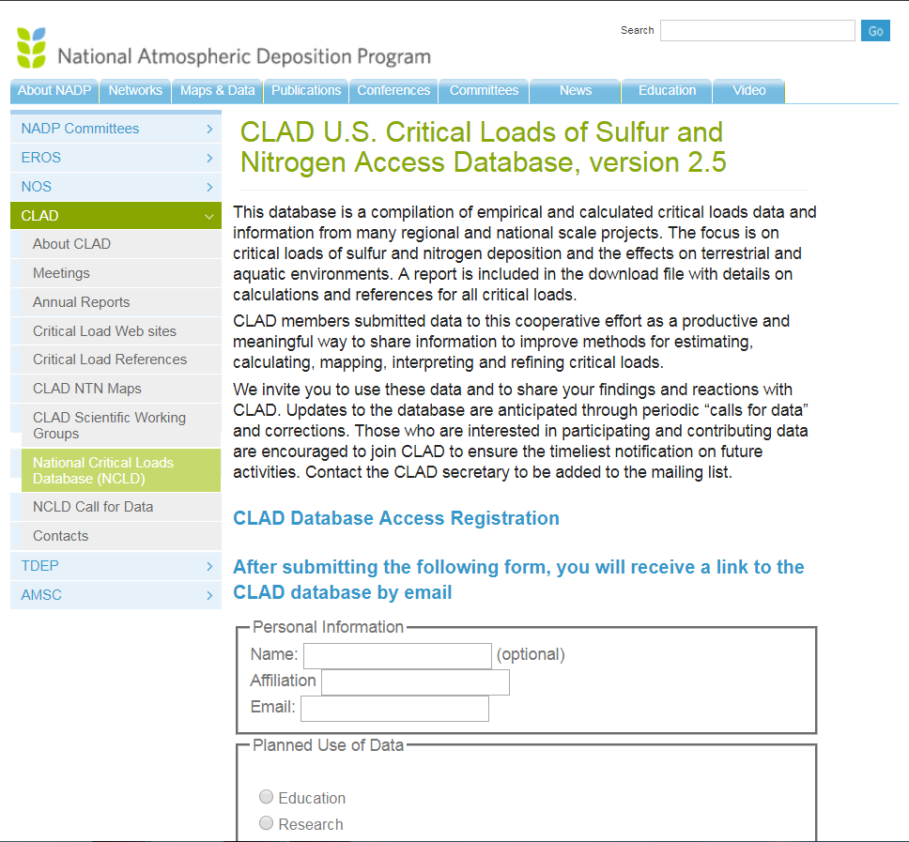
NADP-CLAD - Products
National Critical Load Database (NCLD)
  Developed and updated using published research (and data) produced by CLAD members and other scientists in the U.S.
  Critical Load Types within NCLD:
    Terrestrial Forest Soil Acidification
    Aquatic Surface/Drainage Water Acidification
    Empirical Critical Load of Nitrogen:
      Forest ecosystems
      Herbaceous species and shrubs
      Herbaceous biodiversity
      Mycorrhizal fungi
      Lichens
      Nitrate Leaching
Critical Load Maps
Notes:
This slide describes the main products of NADP-CLAD.

Slide 40
References Cited
Nilsson, J. and P. Grennfelt. 1988. Critical loads for sulphur and nitrogen. Report from a workshop held at Skokloster, Sweden 19-24 March 1988. Miljorapport 15, 1-418.
UBA (UmweltBundesAmt). 2004. Manual on methodologies and criteria for mapping critical levels/loads and geographical areas where they are exceeded. Federal Environmental Agency (UmweltBundesAmt), Berlin, Germany. http://www.rivm.nl/en/themasites/icpmm/manual-and-downloads/manual-english/index.html.

Slide 41
Acknowledgements
Presentation was developed by NADP-CLAD Executive Team (Jennifer Phelan, Tonnie Cummings, Jason Lynch, and Michael Bell)
Slides and/or content were contributed by Tamara Blett (NPS), Linda Pardo (USFS), Linda Geiser (USFS), Ellen Porter (NPS), and Rebecca Evans (WSU)
Sources of data and figures are acknowledge on slides
Cited references are listed in the References cited slide

Slide 43
EXTRA SLIDES / LIBRARY OF ADDITIONAL CL SLIDES
The following slides are extra slides from different CL presentations that are not to include in the slide deck for the CLAD CL presentation, but may be useful for your presentation needs
Note: these slides have been copied and pasted from their source (and therefore may not be consistent in style, format or content with main presentation slides)

Slide 44
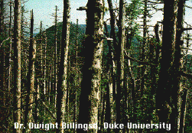

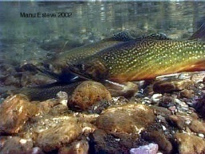
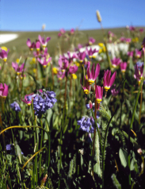
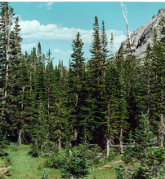
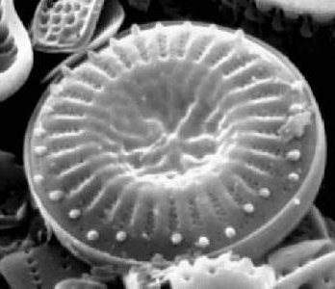
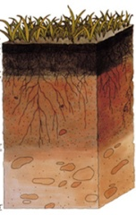
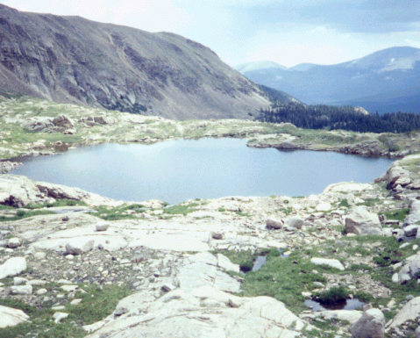
Target Load
Forest decline (acidification effects on trees)
H
Lethal effects on fish, other aquatic animals (chronic acidification)
G
H
Effects on aquatic animals (episodic acidification)
F
G
Change in alpine
plant species
E
F
Changes in tree chemistry
D
E
Surface water N saturation
C
D
C
Change in aquatic plant species composition
B
B
Current deposition level
Changes in soil & water chemistry
Target Load
A
A
N Load (kg/ ha /yr)

Slide 45
Critical Loads for U.S. Ecosystems
From NADP-CLAD National Critical Load Database (NCLD) v3.0
Notes:
Note – have a variety of Critical Load names that range from mechanism (e.g., surface water acidification) to biological receptor (e.g., mycorrhizal fungi) to chemical criterion (e.g., nitrate leaching). But all are ultimately connected to the biological receptor that are protecting.

Slide 46
Target Load Definition
The deposition load that is selected or determined to provide a level of protection for or recovery of sensitive ecosystem components based on time frame for resource protection, feasibility of emissions reductions, and/or other considerations.
Target loads can be determined through management or policy considerations, or by using dynamic process-based models that calculate the deposition load that leads to a desired chemical or biological state of an ecosystem in a given future year (Posch et al. 2003). The target load may be set higher or lower than or equal to the critical load. Target load has sometimes been referred to as “dynamic critical load.”

Slide 47

Critical Loads and Target Loads
A critical load is based on studies or modeling and is the amount of pollution below which harmful environmental effects are not expected to occur. (Science-based)
A target load identifies an acceptable amount of pollution and is based on policy, economic, temporal, or other considerations. A target load may be higher or lower than a critical load. (Management decision)

Slide 48

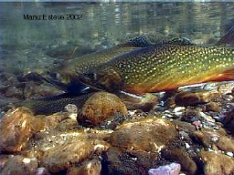
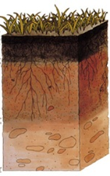
Rocky Mountain National Park: Continuum of Impacts to Ecological Health
Rocky Mountain National Park: Continuum of Impacts to Ecological Health
Current N deposition in Rocky Mountain NP
N Load (kg/ ha /yr)- wet
3.1 kg/ha/yr
Aquatic Ecosystem Critical Load
1.5 kg/ha/yr
“weight of evidence” of ecosystem health decline on east side of park
Natural background N deposition
0.2 kg/ha/yr
Effects on aquatic animals (episodic acidification)
Forest decline (acidification effects on trees)
Changes in soil & water chemistry
Surface water N saturation
Changes in tree chemistry
Change in aquatic plant species composition
Change in alpine
plant species
Lethal effects on fish, other aquatic animals (chronic acidification)
Notes:
How much N is 4 kg/ha/yr? About 943,771 20 lb bags of N
Some initial computer ecosystem modeling has been done to estimate how long (at current deposition rates of about 2% increase/yr) before we get to effects on fish and other aquatic animals.. Not just about preventing dead fish.. but about current effects on ecosystem health already documented.

Slide 49


Notes:
You could develop a critical load for the amount of sunshine you can handle before you get a burn.
So maybe you can spend 15 minutes in the sun but anything over that and you start turning red
We can apply the same idea to nitrogen.
Maybe a high alpine meadow can tolerate 3 kg N/ha/yr but anything over that and we start seeing shifts in plant communities.
The goal is to reduce nitrogen effects to conserve delicate systems.

Slide 50


Too much of a good thing
Notes:
Sometimes you can have too much of a good thing for example: sunshine, we love it especially around here after a long winter. We need it so we can produce vitamin d to keep our bones strong, but too much sunlight and we get sunburnt.

Slide 51
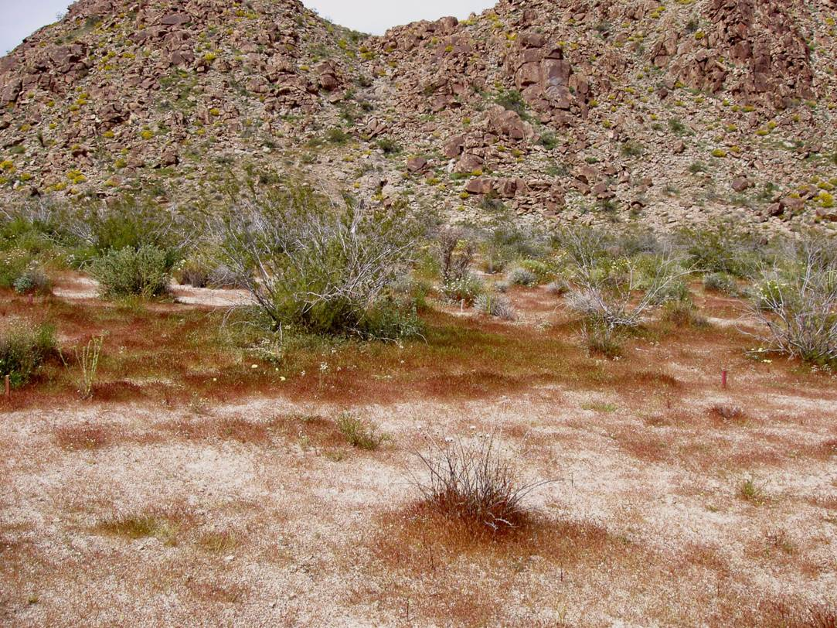
More invasion
Increased plant available N more accessible by invasive species.
Native also enhanced, but often outcompeted by invasives
Can enhance rate of
invasion and allow
species to invade
previously undisturbed
habitat

Slide 52
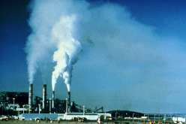


Critical Load
The threshold of deposition below which specified harmful ecological effects do not occur (Porter et al. 2005)
Pollutant Load
SO4, NH4, NO3, Hg, POPs, NOx, SO2
Chemical Variables
ANC, pH, Nitrogen,
Base Saturation, Ca/Al
Biological Responses
Death of Indicator species, Decline in Condition of individuals
Decreased Reproductive Success

Slide 53
Environmental harm caused by acidifying and fertilizing pollutants
Both S and N deposition can acidify surface waters and soils. ↑acidity lowers water pH, harming fish and invertebrate health. Acidity may harm soil fertility by removing calcium and releasing toxic aluminum, impacting plants and animals.
N deposition also fertilizes the environment, favoring some plant species and inhibiting others → changing species composition and abundance.
N deposition → ↑ nutrient enrichment in freshwater, coastal, and estuarine ecosystems, which may cause toxic algal blooms, fish kills, and loss of biodiversity.
When critical loads are exceeded, the environmental effects can extend over great distances. For example, excess nitrogen can change soil and surface water chemistry, which in turn can cause eutrophication of downstream estuaries.
Target loads are based on critical loads, but can include consideration of the timeframe needed to achieve a desired ecosystem condition as well as incorporating policy or management goals.
Notes:
Acidifying and fertilizing pollutants have many harmful effects on the environment– they acidify surface waters and soils that can harm fish and aquatic invertebrates. Acidit also harms soils by removing calcium and releasing aluminum, slowing plant growth. Too much fertilizer tends to favor weedy plants over native plants adapted to lower fertility soils. N deposition to aquatic systems can cause algal blooms, fish kills and lower biodiverity.—and these effects can extend over great distances.
Target loads can be set at or higher than critical loads to achieve a desired ecological condition or set a policy or management goal.

Slide 54
Critical load definition
The term critical load is used to describe the threshold of air pollution deposition that causes harm to sensitive resources in an ecosystem.
Critical loads work has focused on nitrogen (N) and sulfur (S) air pollutants that are deposited into ecosystems.
Critical loads are typically expressed in terms of kilograms per hectare per year (kg/ha/yr) of wet or total (wet + dry) deposition.
Critical loads can be developed for a variety of ecosystem responses, including shifts in microscopic aquatic species, increases in invasive grass species, changes in soil chemistry affecting tree growth, and lake and stream acidification to levels that can no longer support fish.
They can be used to assess ecosystem health, guide resource management decisions, and evaluate the effectiveness of emissions reduction strategies.
Notes:
The term critical load….

Slide 55
Publically accessible tools in development
USDA-Forest Service Air Quality Portal (available now)
  Uses a decision tree format to guide managers to identify areas with CL exceedance and determine potential mitigation activities
    https://www.srs.fs.usda.gov/airqualityportal/
USDA-Forest Service N-CLAS tool (in development)
  Uses a 4-step process to identify the area of concern, select a species or community type, and make on-the-fly charts and figures of CLs and relative risks and uncertainties at current deposition levels
US EPA Critical Loads Mapper (in development)
  Archives the most recent deposition and critical loads estimates and allows user to map exceedances for any management unit or critical load
Notes:
The USDA FS and EPA are working on several tools to utilize critical loads - AQ Portal, NCLAS, and the CL Mapper. The first one is publically accessible already and the other two are in development. These allow managers to determine critical loads and assess risk.

Slide 56
Why do we care? – original version of slide
Changes vegetation patterns
Decreases biodiversity
Can increase rates of change from shifting climate
Reduces quality of the visitor experience

Slide 57
Ecological Impacts of N deposition
Landscape
  Synergistic effects of Climate Change / Development / Fire / Invasive Grasses (Rao et al. 2010, Talluto and Suding 2008)
Exotic Species
Urbanization
Fire
Nitrogen Deposition

Slide 58
Notes:
The NPS has been monitoring the amount of deposition and doing research on the effects of nitrogen deposition on ecosystems.
We are hoping to develop critical loads, A term used to describe the amount of pollution an organism or ecosystem can withstand before harmful effects occur.
Here we see that at a certain amount of N we start to see changes in phytoplankton, then changes in soil then changes in alpine plant diversity.

Slide 59
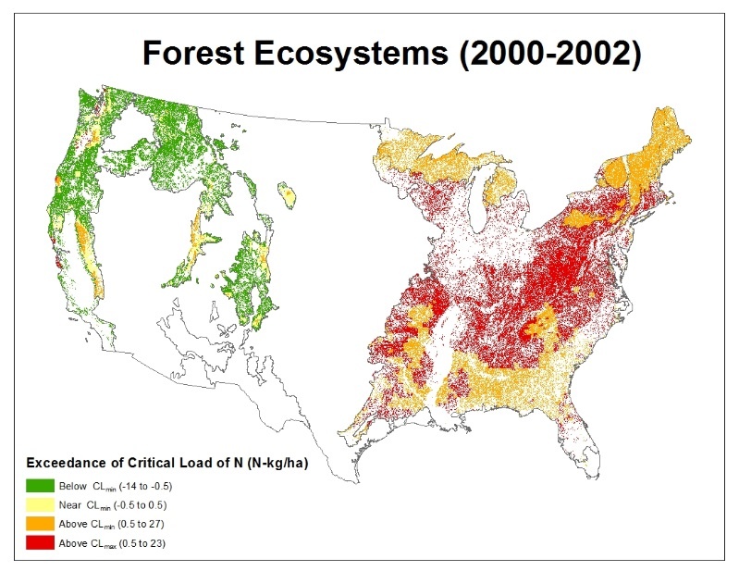
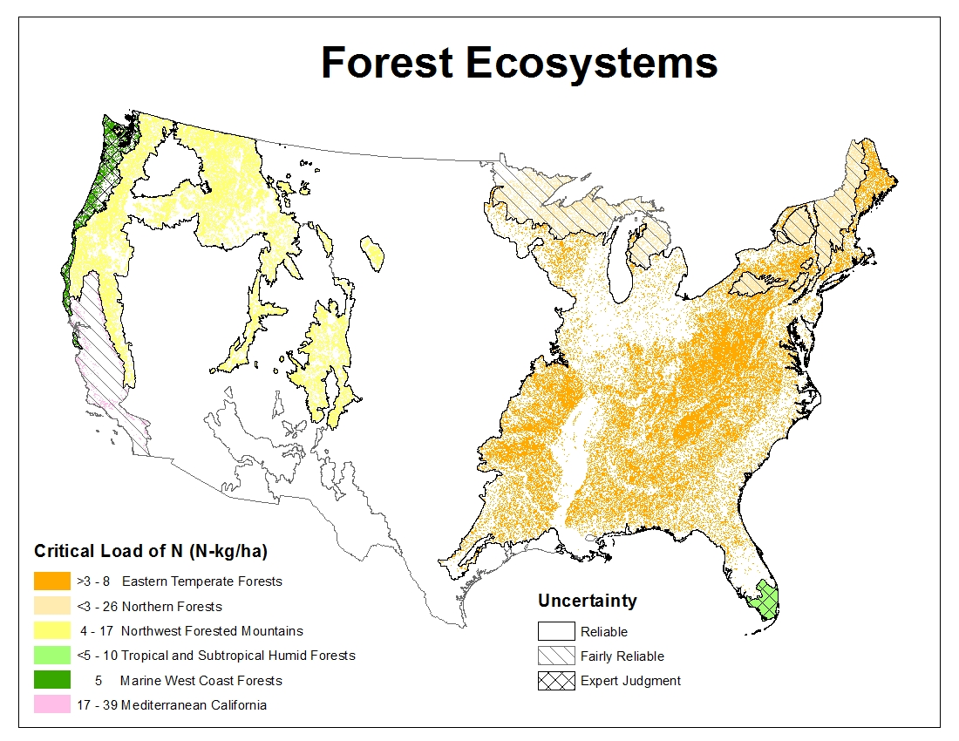
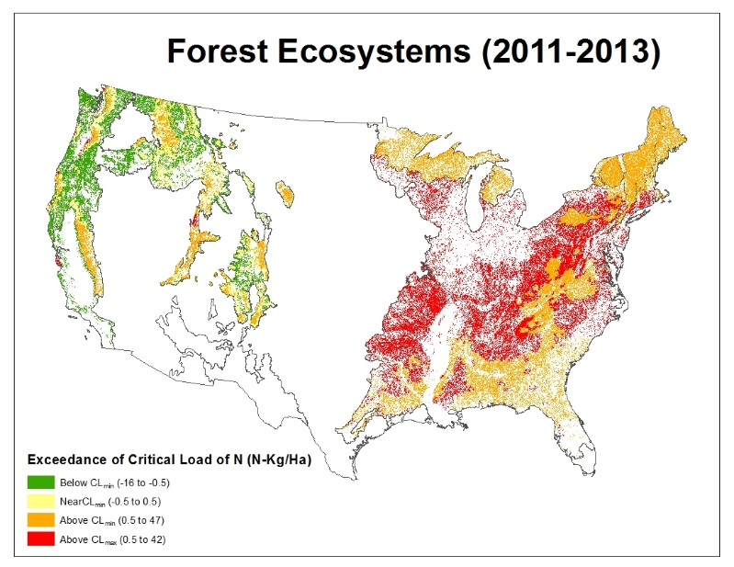
Critical Load and Exceedance Maps
Notes:
- Add in notes to remind people that maps are CLAD

Slide 60
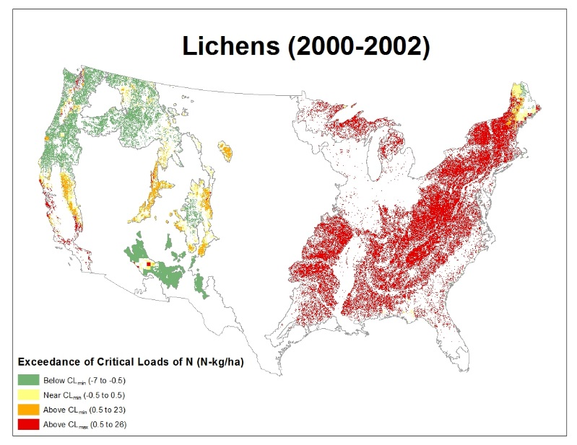
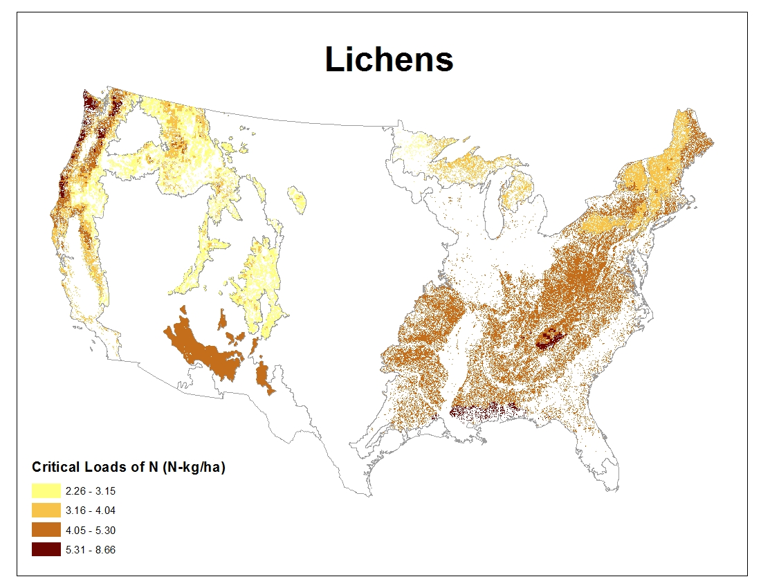
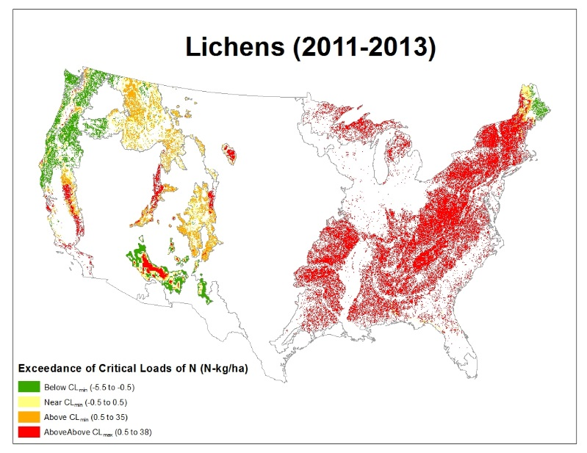
Critical Load and Exceedance Maps

Slide 61
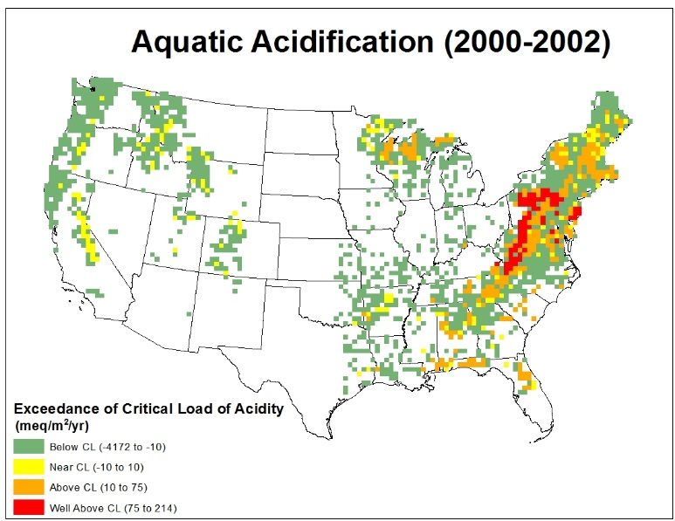
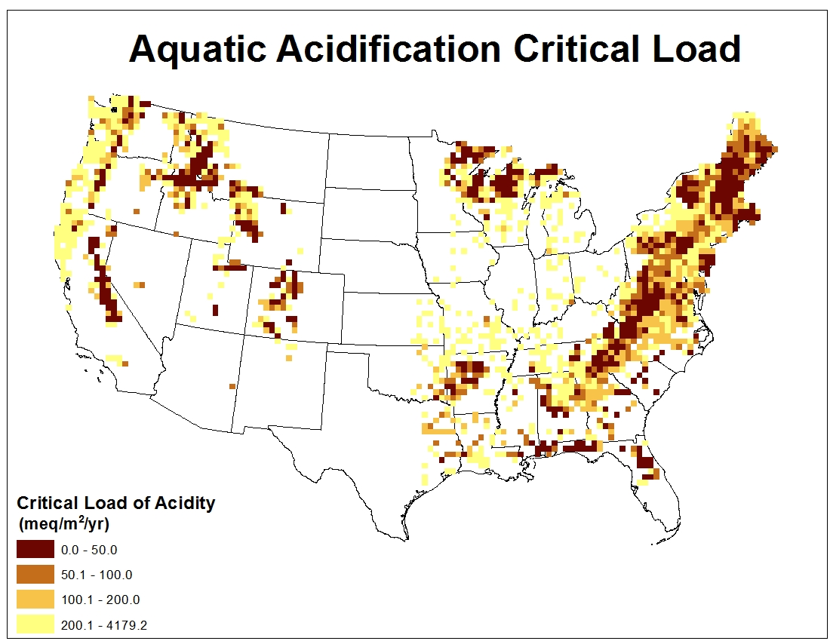
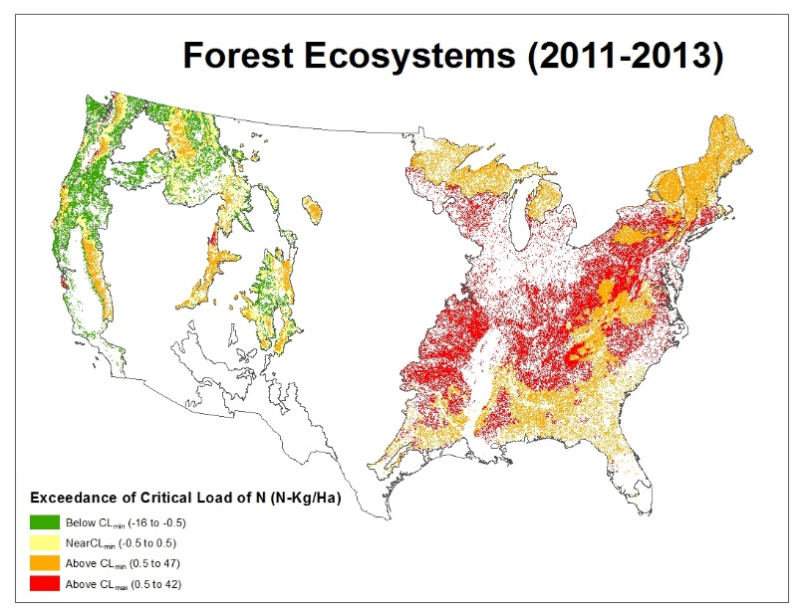

Critical Load and Exceedance Maps

